Slide 1
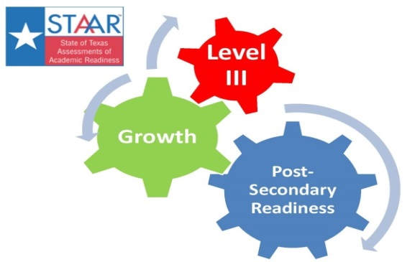
Indices, Instruction, and Intellectualism!
Ty Duncan, Coordinator of Accountability and Compliance – tduncan@esc17.net
@instructionalle #esc17

Slide 2
https://todaysmeet.com/ESC17TEPSA
Join the Conversation!!!

Slide 3


#ESC17
#TEPSA 15
@instructionalle

Slide 4
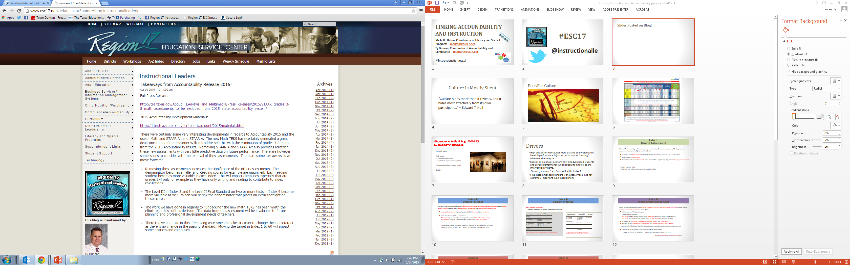
Slides Posted on Blog!
http://www.esc17.net/default.aspx?name=blog.instructionalleaders

Slide 5



Slide 7

Index Drivers
Level III performance is just as important as passing.
Growth mindset for Index 2
Aligned systems

Slide 8
Recognizing the Intellectual
Complexity of Teaching
In “Democratic Teaching: An Incomplete Job Description,” Bradshaw (2014) begins by sharing a view of teaching as described in popular media through the documentary American Teacher and comments that unfortunately, “the film’s portrait of teachers invites more pity than awe” (p. 2). She
argues that the misconception of teaching as a nonintellectual practice “threatens the very foundations of our political system” (p. 1). Bradshaw believes that teaching with, about, for, in, and out of democracy is a complex responsibility with many nuances that inform and impact practice in the classroom resonating throughout the country and history.
http://democracyeducationjournal.org/cgi/viewcontent.cgi?article=1155&context=home

Slide 9
Recognizing the Intellectual
Complexity of Teaching
Their conclusion:
Teaching is an intellectual endeavor. Teachers are more than technicians who implement the latest fix and then move on. The best teaching and learning that anyone experiences require great effort on the part of the teacher and the students. In my opinion and experience, “those who can’t do, teach” (Shaw, 1903) is a fallacy in most situations.
http://democracyeducationjournal.org/cgi/viewcontent.cgi?article=1155&context=home

Slide 10
https://todaysmeet.com/ESC17TEPSA
Join the Conversation!!!

Slide 11

Would you describe your school as an intellectual place with intellectual conversations and sophisticated work?

Slide 12
Impact

Slide 13
Students Must See Teachers Doing Intellectual Work!
Instructional Rounds – Teachers engaging in intellectual work and dialogue around their own practice is beneficial for the STUDENTS.
Engaging in Sophisticated Dialogue – How often do students see teachers engaging in dialogue about the content they are teaching.
Blogs! – Stop doing things that do not matter and do this! Every teacher needs one. It will make them smarter!

Slide 14
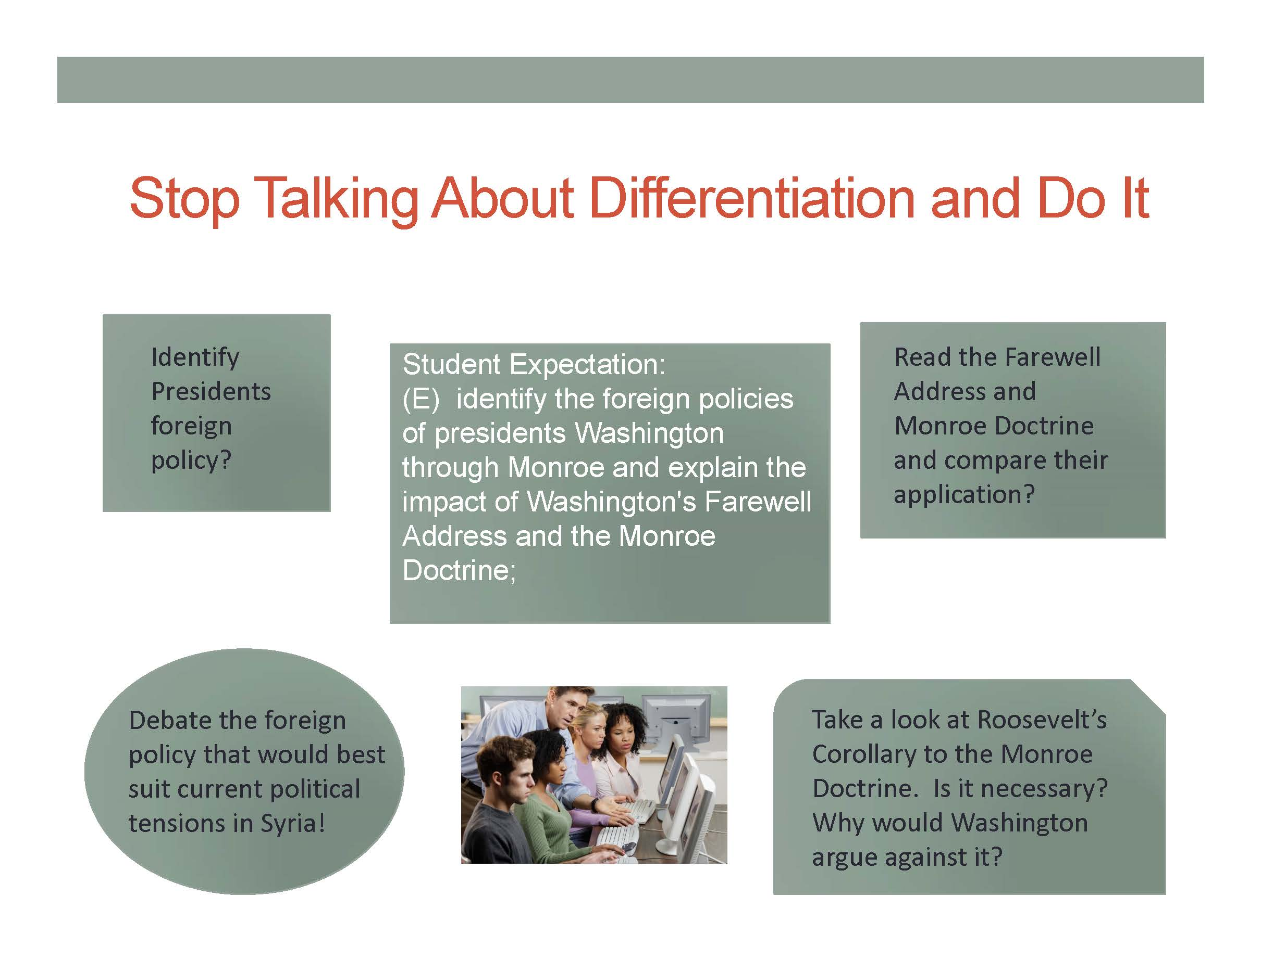
Changing a View of the “The Work”
http://www.esc17.net/default.aspx?name=blog.instructionalleaders&from=10/1/2013&to=10/31/2013

Slide 15

Grading Volume of Work and Not Depth of Work Decrease Intellectualism at School

Slide 16
Impact

Slide 17
Culture Is Mostly Silent
“Culture hides more than it reveals, and it hides most effectively from its own participants.” – Edward T. Hall

Slide 18
https://todaysmeet.com/ESC17TEPSA
Join the Conversation!!!

Slide 19
#ESC17
#TEPSA15
@instructionalle

Slide 20
Indices, Instruction, and Intellectualism!
Ty Duncan, Coordinator of Accountability and Compliance – tduncan@esc17.net
@instructionalle #esc17

